Slide 1
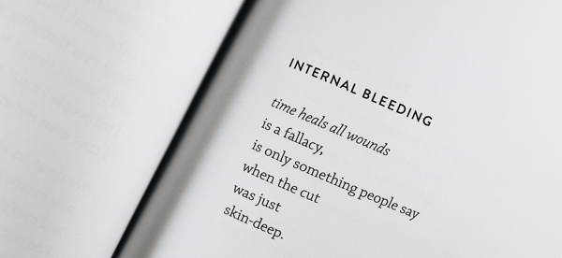
GCSE to A Level Word Power
Substituting Words

Slide 2
Substituting Words Exercise One The Storm
Improve the power of the sentences given by substituting one of the three alternatives for the word/phrase in italics.
Make sure you have looked up and understood any of the suggested words that are unfamiliar before making your choice and giving your reasons for it.
Remember that one of the key level descriptors in GCSE refers to overall coherence and cohesion, so besides accentuating and emphasising local effects your choices should make sense in the overall context of what is presented.

Slide 3
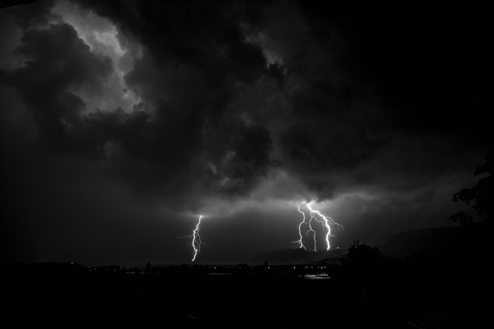

Slide 4
Substituting Words
Exercise One
The Storm
Rain was dripping from the sky. The weather was cold. The wind was blowing as fast as a cheetah. Across the dark black sky.

Slide 5
Substituting Words
Exercise One
The Storm
Rain was dripping from the sky.
deluging/ pelting/ lashing down
What are the effects of your choice?

Slide 6
Substituting Words
Exercise One
The Storm
The weather was cold.
chilly/ threatening/ wintry
What are the effects of your choice?

Slide 7
Substituting Words
Exercise One
The Storm
The wind was blowing as fast as a cheetah.
at gale force/ relentlessly/ unmercifully
What are the effects of your choice?

Slide 8
Substituting Words
Exercise One
The Storm
Across the dark black sky.
indigo/ storm clouded/ troubled
What are the effects of your choice?
How have you worked on the overall coherence of the paragraph?

Slide 10
Substituting Words
Exercise Two
A Horror Story
The streets gloomed with fear. Noises were suggestive. The thing approached me.

Slide 11
Substituting Words
Exercise Two
A Horror Story
The streets gloomed with fear.
echoed/ stank of/ were suffused with
What are the effects of your choice?

Slide 12
Substituting Words
Exercise Two
A Horror Story
Noises were suggestive.
scary/ eerie/ amplified
What are the effects of your choice?

Slide 13
Substituting Words
Exercise Two
A Horror Story
The thing approached me.
creature/ emanation/ phantom
What are the effects of your choice?
How have you worked on the overall coherence of the paragraph?

Slide 15
Substituting Words
Exercise Three
The Football Match
We eventually got to the stadium and it just got better and better. It wasn't the game but the good feeling it gave me being there. I loved being around so many people with one common interest.

Slide 16
Substituting Words
Exercise Three
The Football Match
We eventually got to the stadium and it just got better and better
the atmosphere/ the ambience/ the excitement
What are the effects of your choice?

Slide 17
Substituting Words
Exercise Three
The Football Match
It wasn't the game but the good feeling it gave me being there.
sheer pleasure / adrenalin rush/ ecstasy
What are the effects of your choice?

Slide 18
Substituting Words
Exercise Three
The Football Match
I loved being around so many people with one common interest
shared loyalty/ passionate commitment/ single purpose
What are the effects of your choice?
How have you worked on the overall coherence of the paragraph?

Slide 19
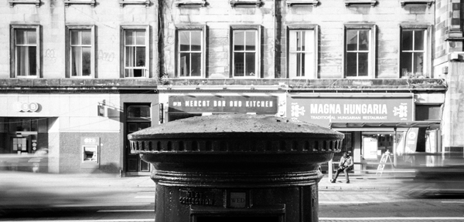

Slide 20
Substituting Words
Exercise Four
The Letter
As I made my way to my mailbox I started feeling uneasy. As I opened the envelope my hands began to shake. When I looked at the signature my confusion increased.

Slide 21
Substituting Words
Exercise Four
The Letter
As I made my way to my mailbox I started feeling uneasy
a sense of dread/ the thrill of anticipation/ in two minds
What are the effects of your choice?

Slide 22
Substituting Words
Exercise Four
The Letter
As I opened the envelope my hands began to shake
my throat became constricted/ my temples started to throb/ the butterflies in my stomach exploded
What are the effects of your choice?

Slide 23
Substituting Words
Exercise Four
The Letter
When I looked at the signature my confusion increased
elation was confirmed/ apprehension multiplied/ despair worsened
What are the effects of your choice?
How have you worked on the overall coherence of the paragraph?

Slide 25
Substituting Words
Exercise Five
Supplementary Exercises
Look back at the reasons you have given for your choices.
How would you have used them to develop any one of the stories to a conclusion?

